Slide 1
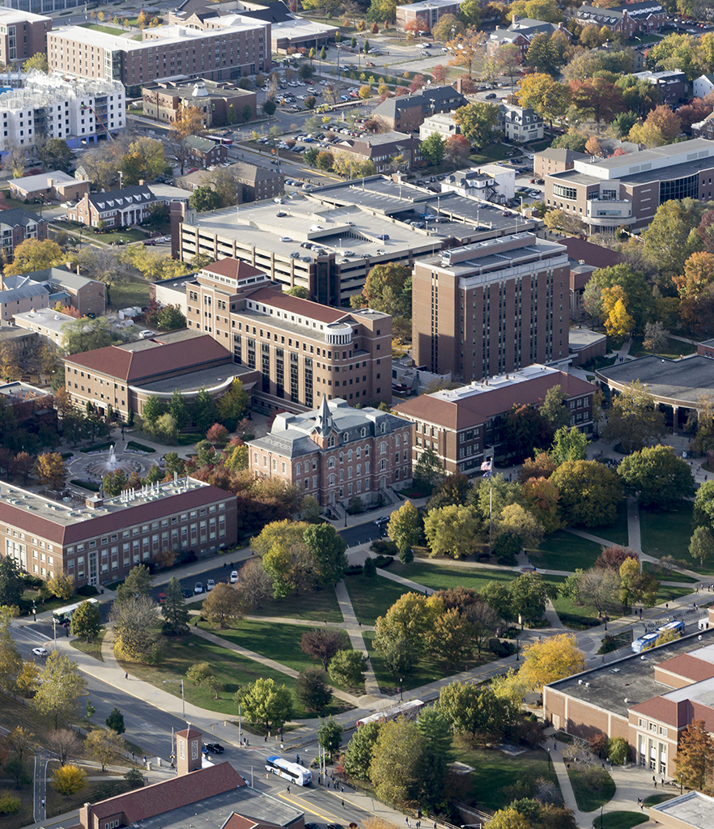
Grid-based Cyclic Multi-robot Allocation for Object Carrying
Jee Hwan Park
School of Mechanical Engineering
07/24/2020

Slide 2

Content
Grid based Cyclic Multi-robot Allocation for object carrying
Introduction
Related Works
Problem Statement
Proposed Solution
Validation
Conclusion & Future works

Slide 3
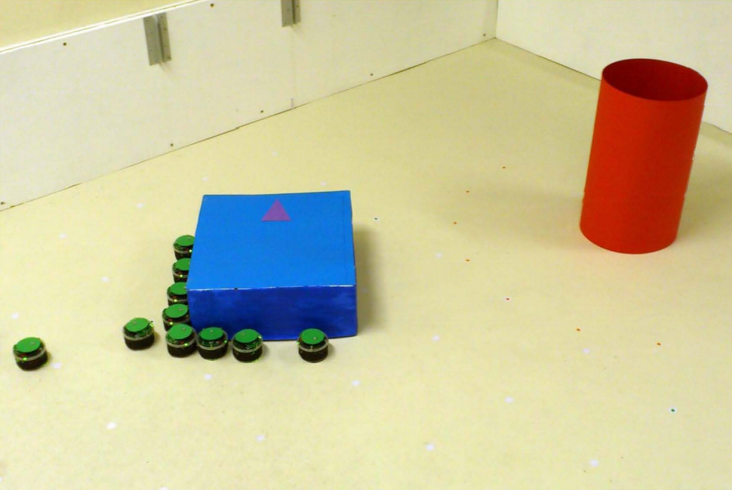
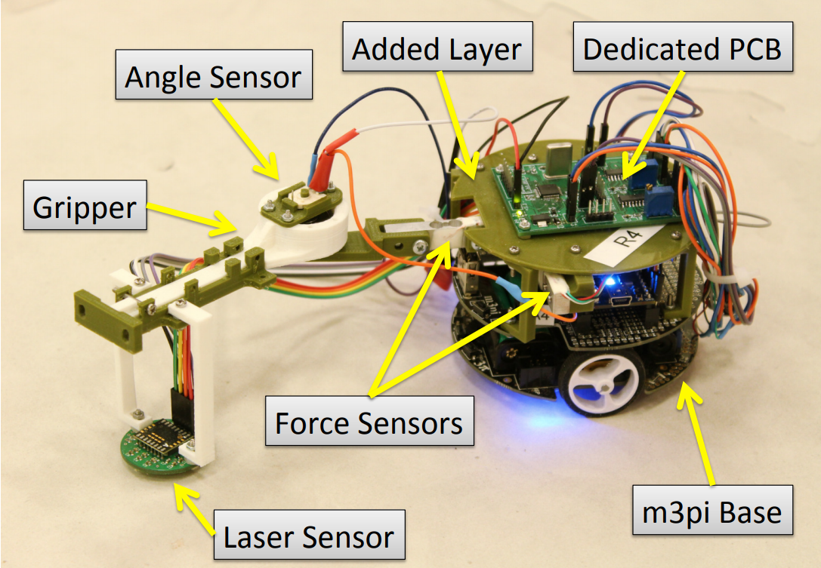
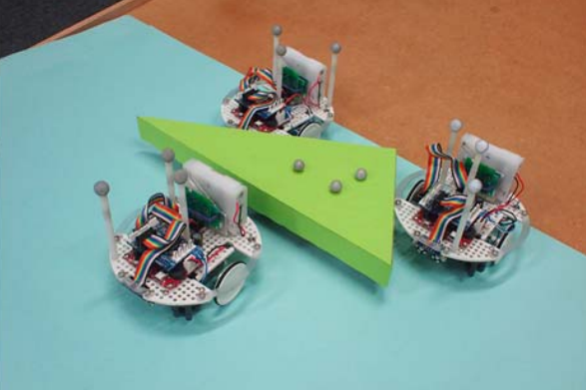
Introduction
Background
Object transportation using multi-robot systems has been a popular research topic due to its robustness and fault tolerant feature.
Traditional methods of object transportations are Pushing, Grasping and Caging.
Pushing mechanism
Grasping mechanism
Caging mechanism

Slide 4
Introduction
Problems statement
Introduced strategies still have some limitations and possible improvable points as follows:
The strategy can be limited based on the weight of the object
Requires robots’ functionalities such as grasping
Alignment of the robot has to be precise to translate the object in desired path

Slide 5
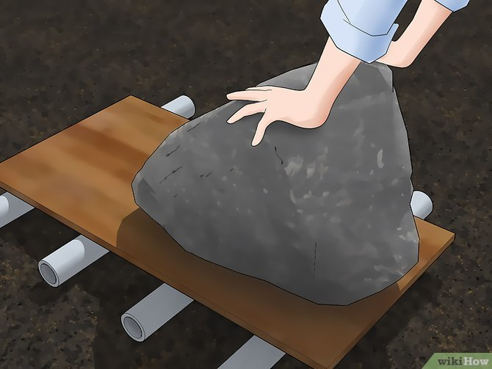

Introduction
Motivation
What can be a possible way to reduce limitations?
Development of idea of object transportation

Slide 6
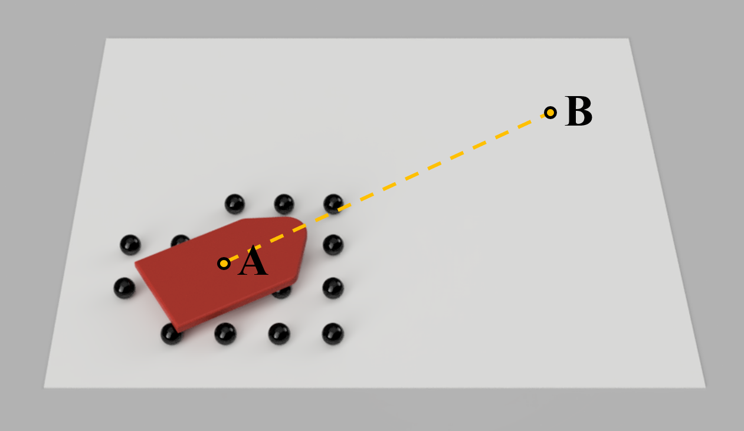
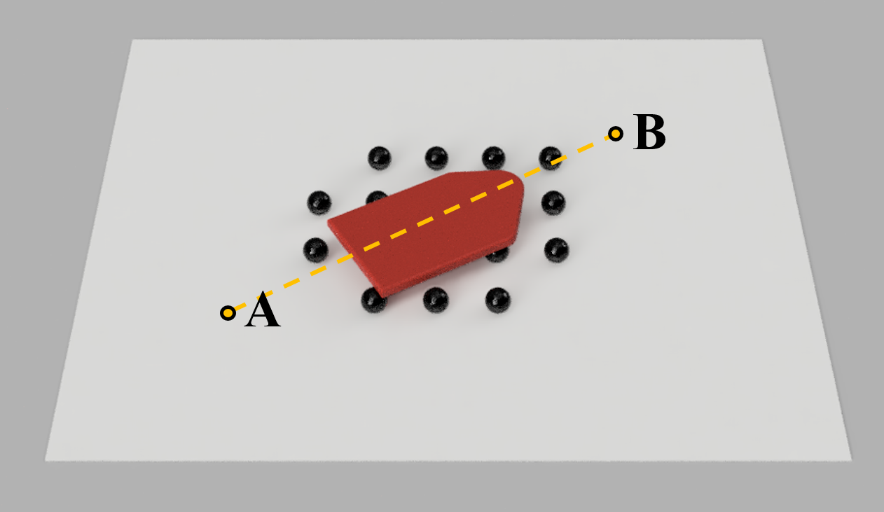
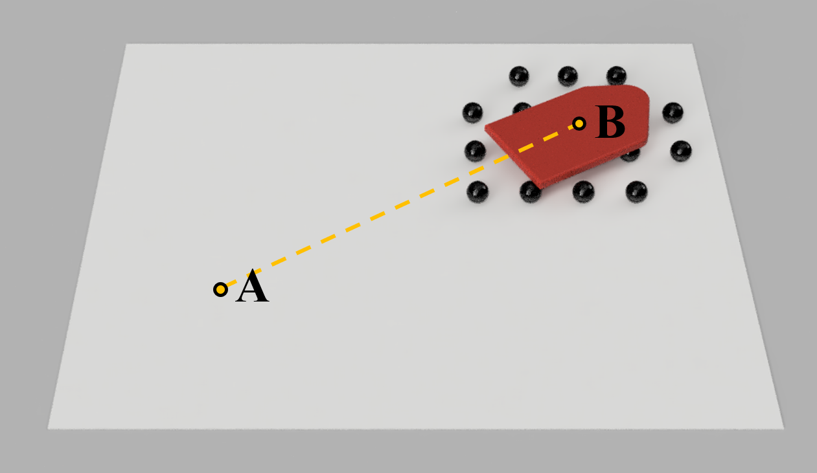
Introduction
Motivation
New method of object transportation using multi-robot system.
Multi-robot system contains group of spherical robots
The transition is caused by the rotation of spherical robots
To maintain the stability while moving, the formation of the robot needs to be designed
3-D Concept of object carrying using multi-spherical robots

Slide 7
Introduction
Research Question
What is the most efficient allocation strategy to ensure the stability of the object during the transportation while using minimum number of robot required?

Slide 8
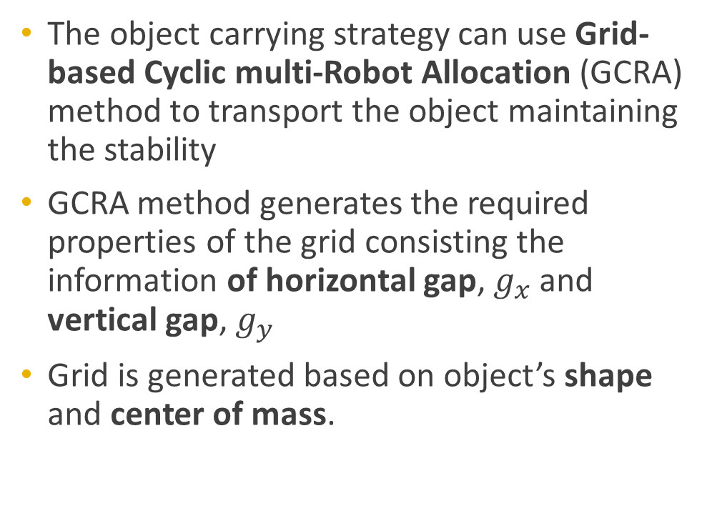
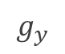
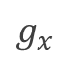
Introduction
Grid-based Cyclic multi-Robot Allocation
The object carrying strategy can use Grid-based Cyclic multi-Robot Allocation (GCRA) method to transport the object maintaining the stability
GCRA method generates the required properties of the grid consisting the information of horizontal gap, $g_{x}$ and vertical gap, $g_{y}$
Grid is generated based on object’s shape and center of mass.
$$g_{y}$$
$g_{x}$
Grid generation concept

Slide 9
Introduction
Assumptions
This thesis has following assumptions:
The system is centralized and position of each robot and the object is known. Each robot has accessibility of the object and other robot's position.
The object has a point contact and there is no slip between the object and the robots.
The object has a flat surface on the contact with robots.

Slide 10
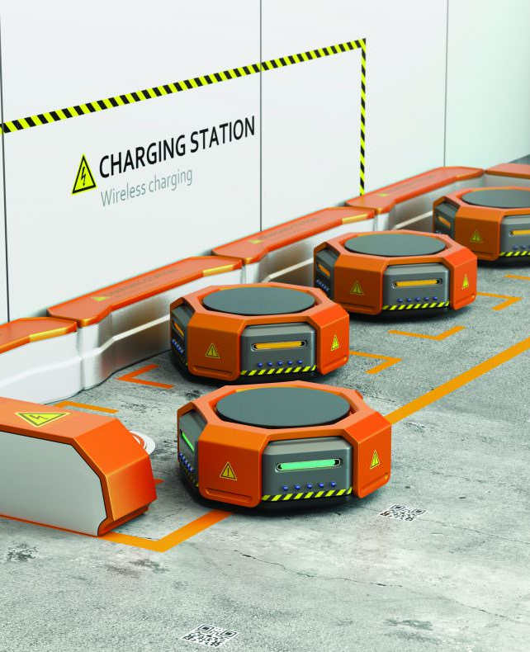
Related Works
Pushing, Grasping and Caging strategies

Slide 11
Related Works
Pushing strategy
Pushing strategy is the methods of using multi-robots that are not attached to the object.
Multi-robots exerts pushing forces on the object to overcome frictional force, gravitational force and other dynamical force during the transportation.
The pushing strategy may appear to be simple but this strategy has challenge of alignment of the total force created by each robots.

Slide 12
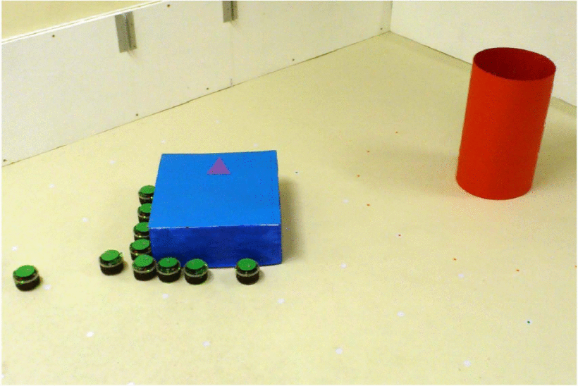
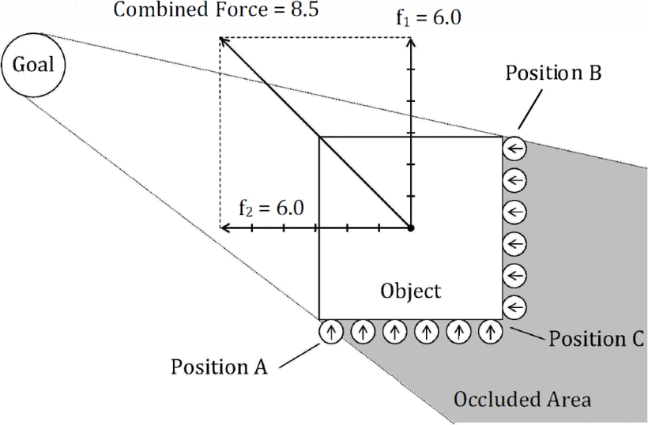
Related Works
Pushing strategy
A strategy for transporting tall objects with a swarm of miniature mobile robots
Uses swarm of mobile robots to push the object to the desired goal.
Finite state machine is designed and each robot relocates to push the object.
Each robot has 8 proximity sensors to detect the object and one color sensor to detect the object and the goal.
Pushing application by Chen and Gauci

Slide 13
Related Works
Grasping strategy
Grasping strategy transports object by a robot that is physically attached to an object.
Strategy can be accomplished using robots with the grasping mechanism such as robotic arms.
grasping strategy provides a better control of the object once it is grasped and lifted.
Re-positioning of the object using this mechanism is dependent on the weight of the object

Slide 14
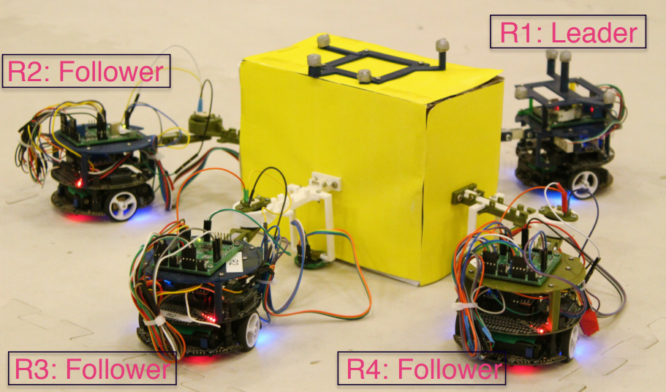
Related Works
Grasping strategy
Kinematic multi-robot manipulation with no communication using force feedback
The application introduces a multi-robot system to transport an object using a group of four robots.
The leading robot pulls the object and perceives the direction towards the goal and other three robots pushes the object to produce enough force.
The control model requires information beforehand such as mass of the object, friction coefficients and total number of the robots forming the group.
Grasping application by Wang and Schwager

Slide 15
Related Works
Caging strategy
Caging strategy intentionally encloses the object by group of robots and ensures that the object follows the planned trajectories.
From the start of the transportation to the end, the object will be surrounded to avoid any desertion from the enclosure.
The main challenge of the strategy is the allocation and positioning of robots.

Slide 16
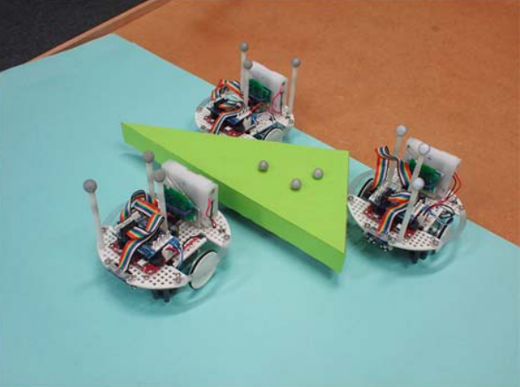
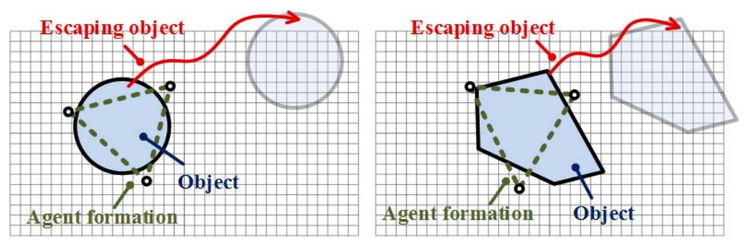
Related Works
Caging strategy
Multirobot Object Transport via Robust Caging
The control algorithm to collectively transport an object using a group of relatively low-cost robots
Uses the quality of complete robustness to first optimize the number of robots in the initial formation, and then reorient and move the formation.
The method is free of force analysis and therefore less prone to sensor errors and failures.
Grasping application by Weiwei and Boxin

Slide 17

Problem Statement
Mathematical problem statement and Definitions

Slide 18
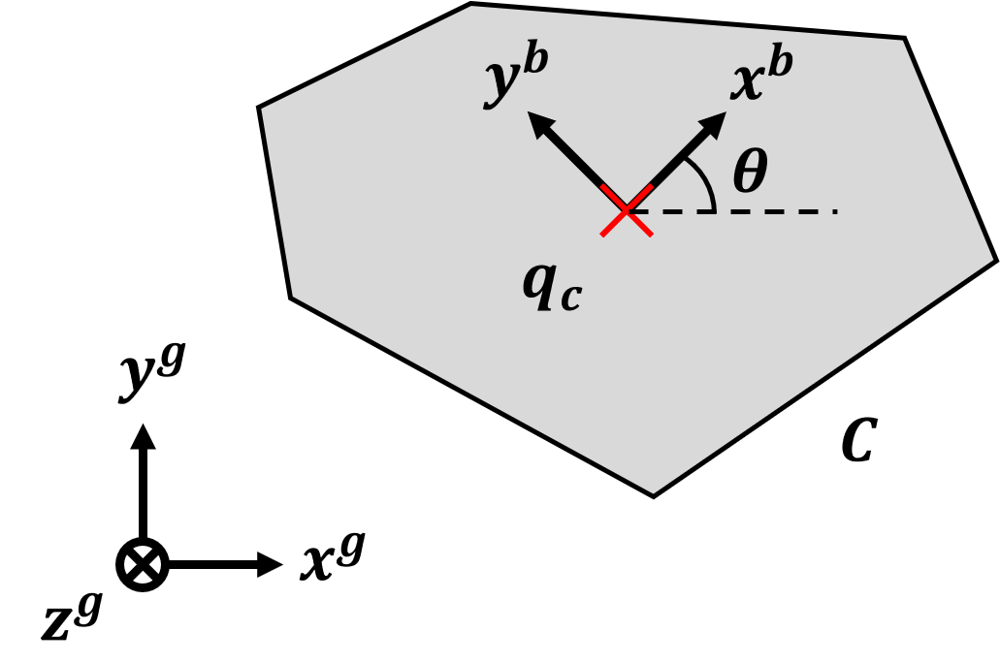
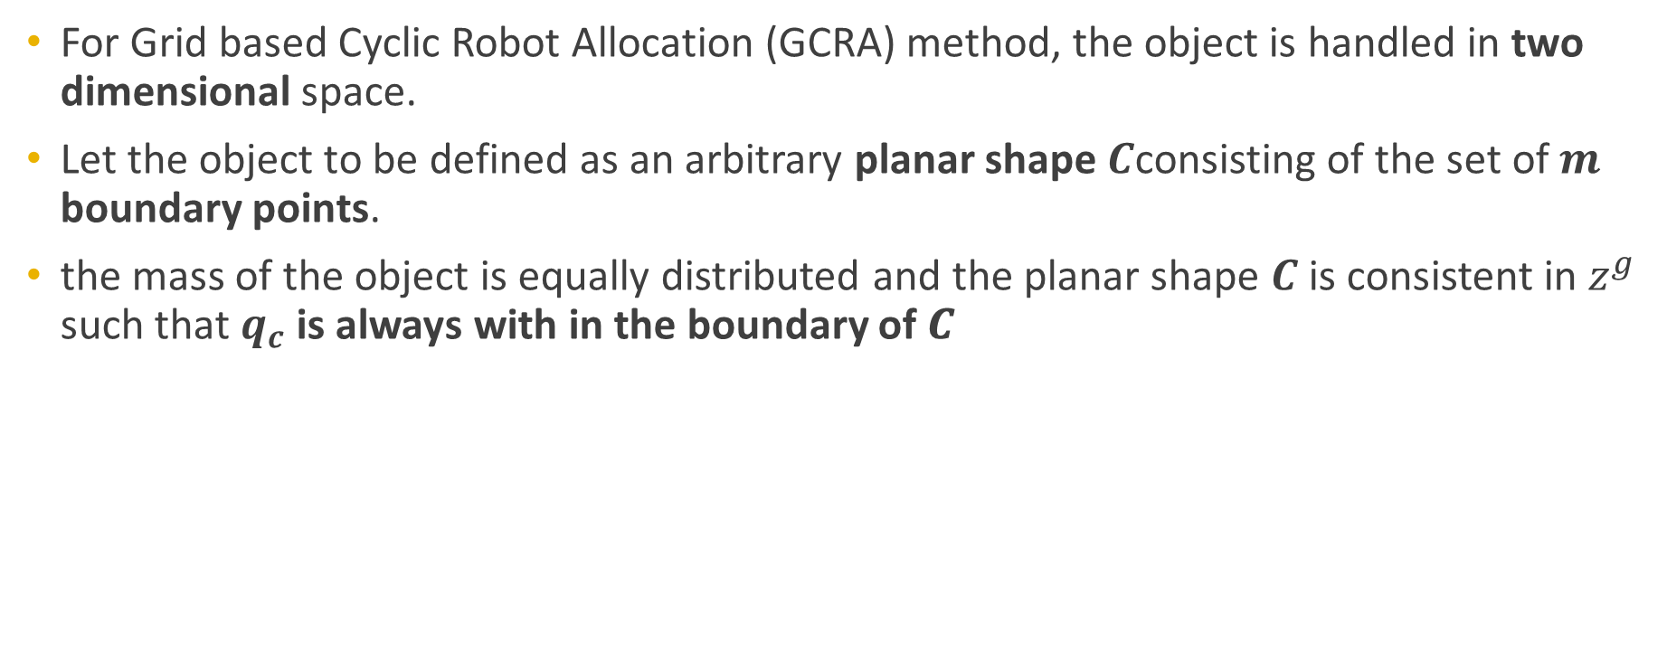
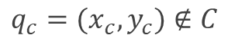
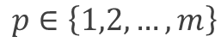
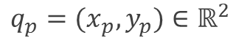
Problem statement
Object define
For Grid based Cyclic Robot Allocation (GCRA) method, the object is handled in two dimensional space.
Let the object to be defined as an arbitrary planar shape $C$consisting of the set of $m$ boundary points.
the mass of the object is equally distributed and the planar shape 𝑪 is consistent in $z^{g}$ such that $q_{c}$ is always with in the boundary of 𝑪
$$q_{p}=(x_{p},y_{p})∈ℝ^{2}$$
$$p∈\left\{1,2,…,m\right\}$$
$$q_{c}=(x_{c},y_{c})∉C$$

Slide 19
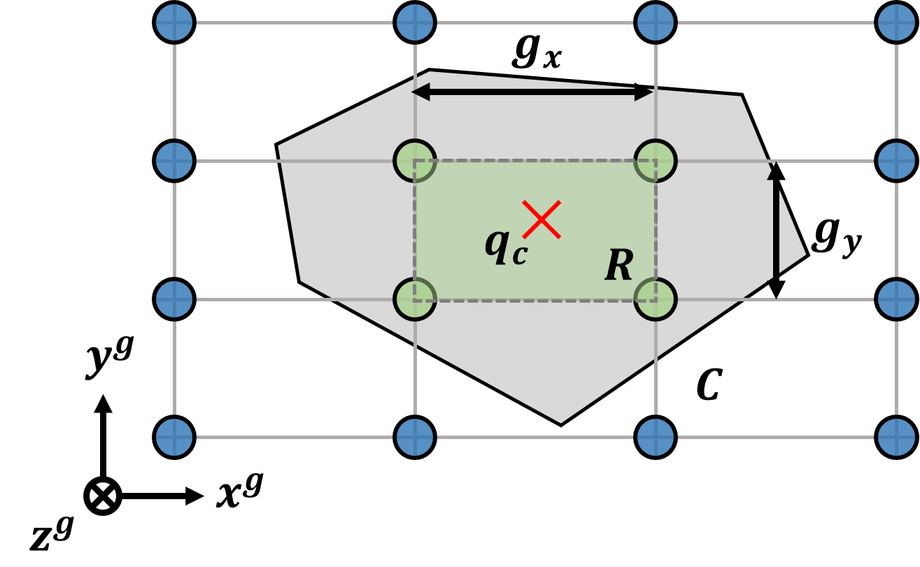
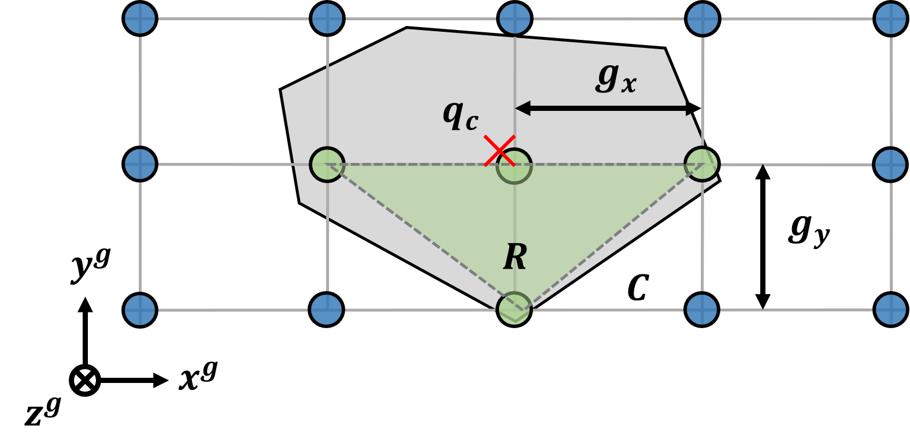
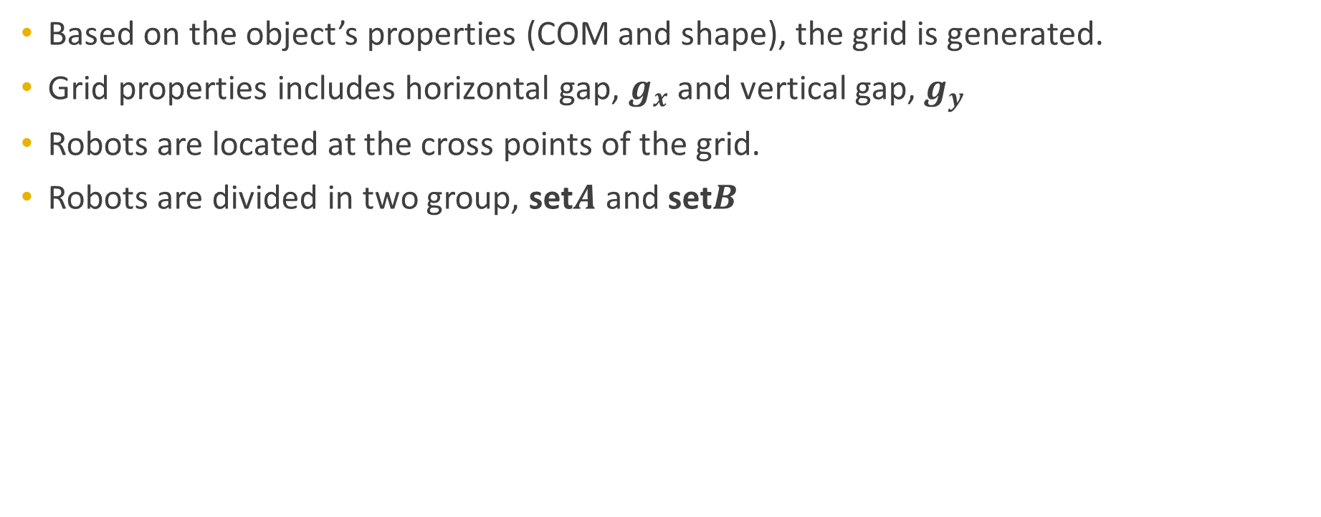
Problem statement
Grid define
Based on the object’s properties (COM and shape), the grid is generated.
Grid properties includes horizontal gap, $g_{x}$ and vertical gap, $g_{y}$
Robots are located at the cross points of the grid.
Robots are divided in two group, set$A$ and set$B$
Stable condition
Unstable condition

Slide 20
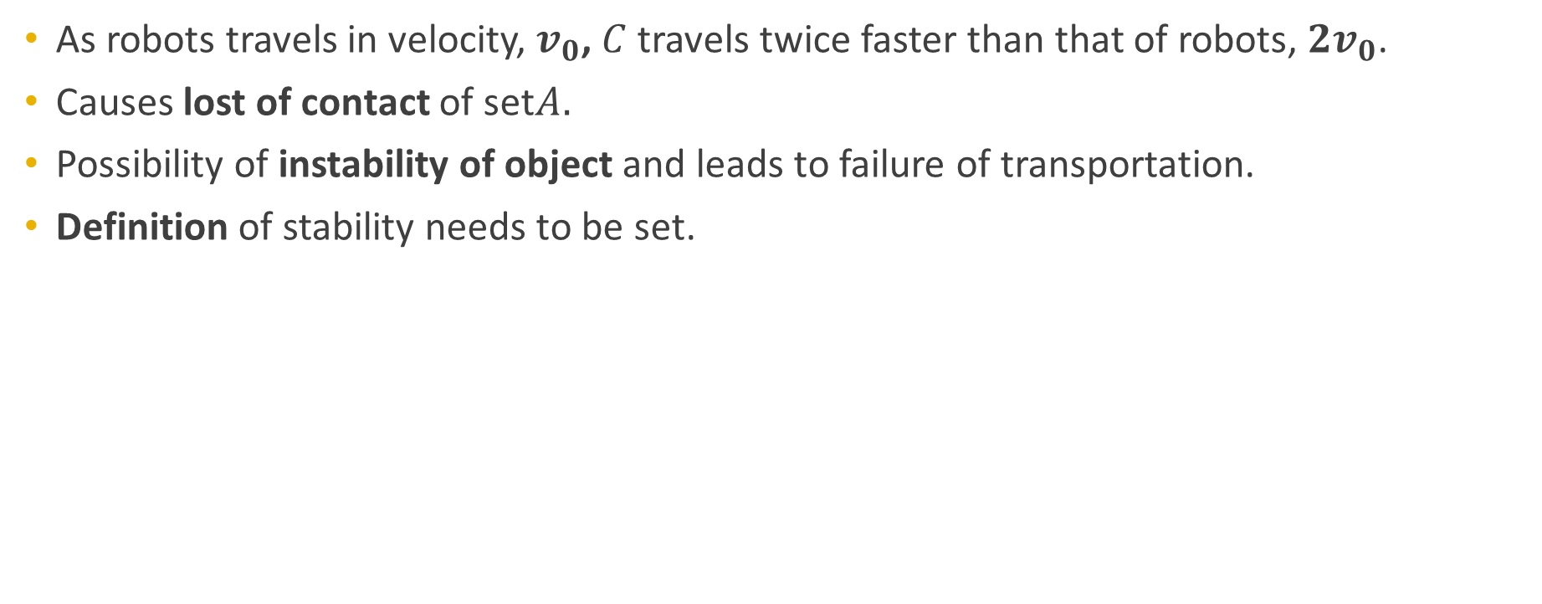
Problem statement
Stability define
As robots travels in velocity, $v_{0}$, $C$ travels twice faster than that of robots, $2v_{0}$.
Causes lost of contact of set$A.$
Possibility of instability of object and leads to failure of transportation.
Definition of stability needs to be set.
Stable condition
Unstable condition

Slide 21
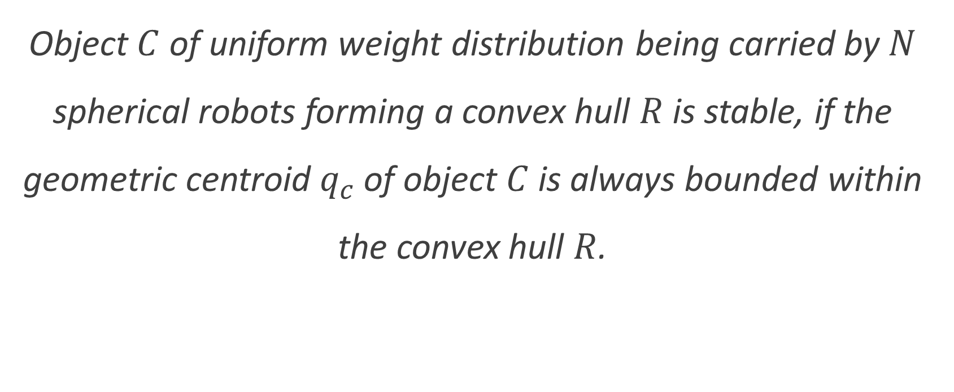
Problem statement
Definition 1
Object $C$ of uniform weight distribution being carried by $N$ spherical robots forming a convex hull $R$is stable, if the geometric centroid $q_{c}$ of object $C$is always bounded within the convex hull $R$.

Slide 22
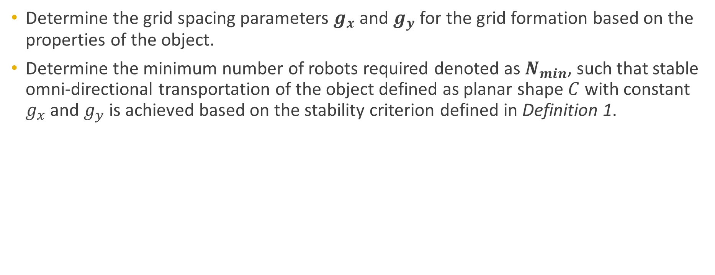
Problem statement
Objective definition
Determine the grid spacing parameters $g_{x}$ and $g_{y}$ for the grid formation based on the properties of the object.
Determine the minimum number of robots required denoted as $N_{min}$, such that stable omni-directional transportation of the object defined as planar shape $C$ with constant $g_{x}$ and $g_{y}$ is achieved based on the stability criterion defined in Definition 1.

Slide 23
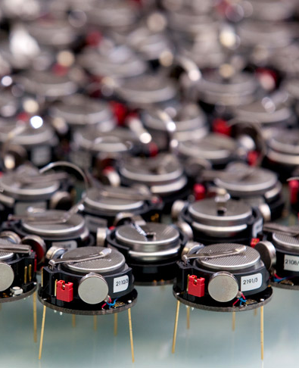
Proposed Solution
Grid generation, Robot allocation and Definition 2

Slide 24

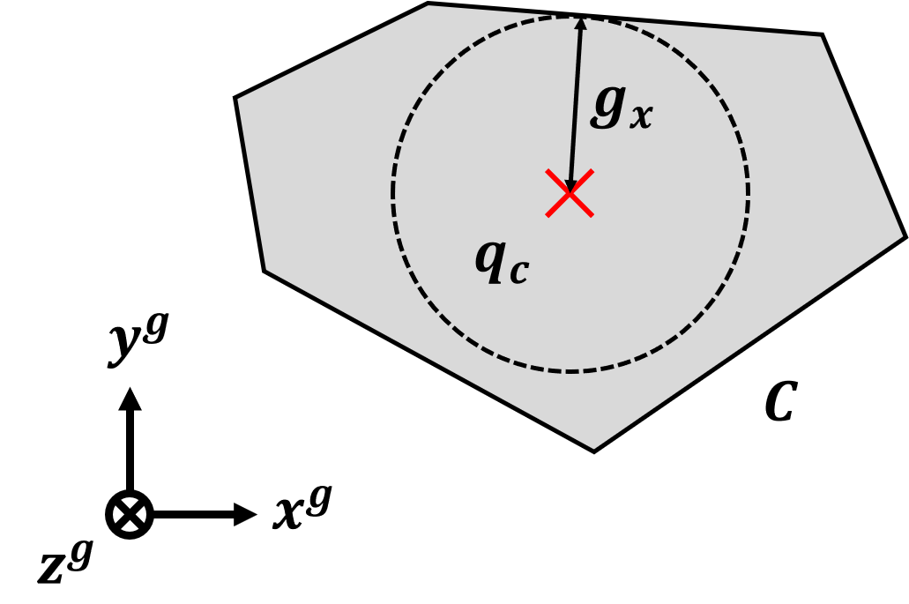
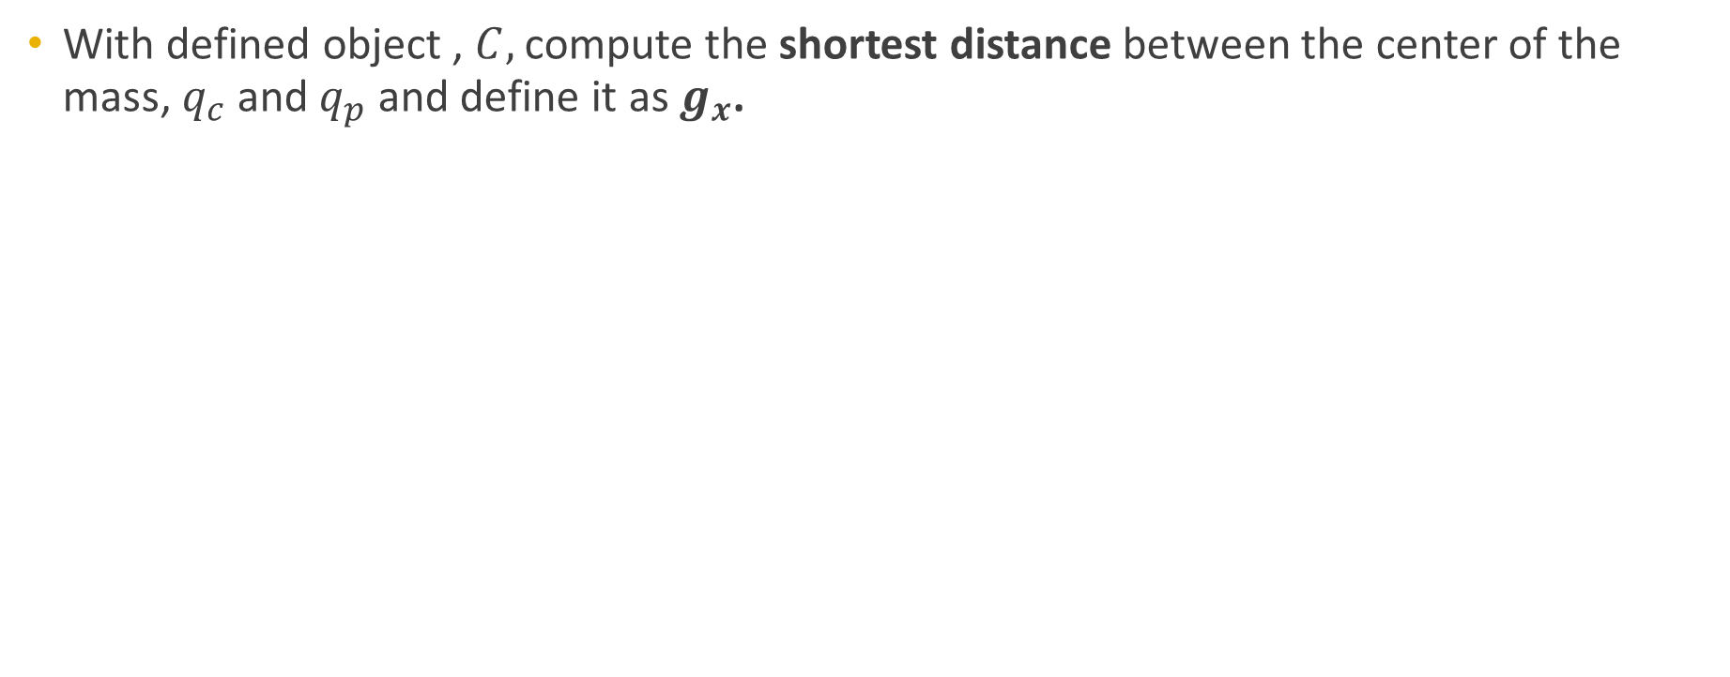
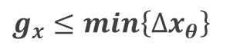
Proposed Solution
Grid generation
With defined object , $C,$ compute the shortest distance between the center of the mass, $q_{c}$and $q_{p}$ and define it as $g_{x}$.
$∆x_{θ}=\left\{\left|x_{c}−x_{p}\right|y_{p}=y_{c},∀\left(x_{p},y_{p}\right)∈C, 0≤θ<2π\right\}$
$g_{x}≤min\left\{∆x_{θ}\right\}$

Slide 25
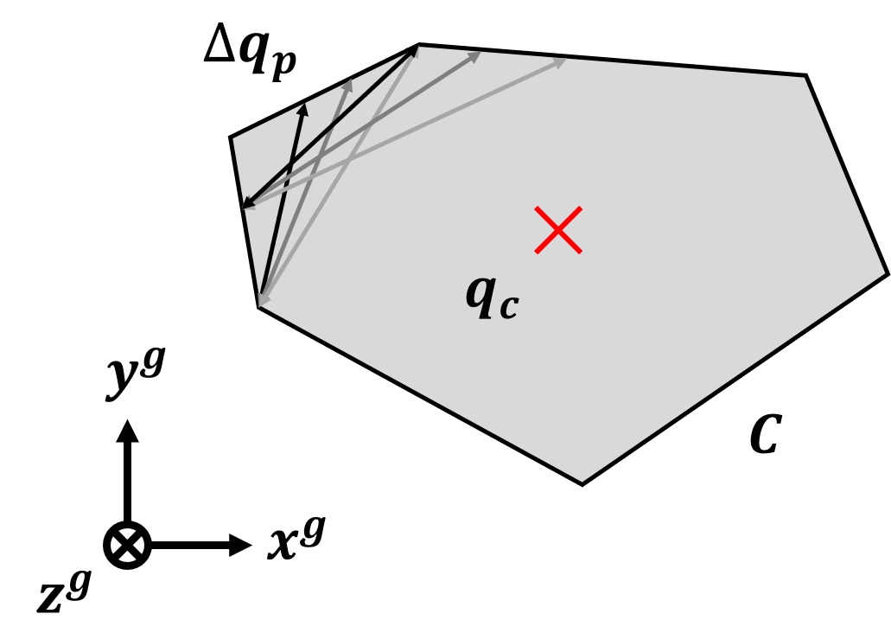
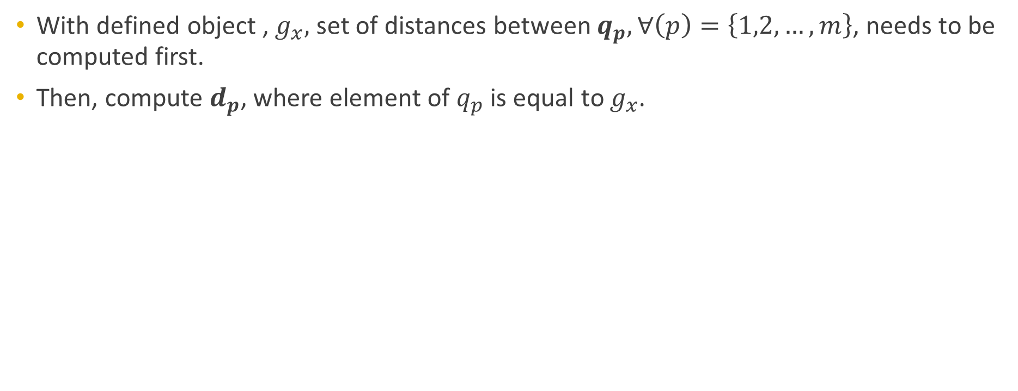
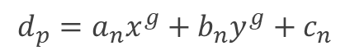
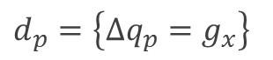
Proposed Solution
Grid generation
With defined object ,${ g}_{x},$ set of distances between $q_{p}, ∀\left(p\right)=\left\{1,2,…,m\right\}$, needs to be computed first.
Then, compute $d_{p}$, where element of $q_{p}$ is equal to $g_{x}$.
$∆q_{p}=\left\{\left|q_{p}−q_{p+1}\right|,∀\left(p\right)=\left\{1,2,…,m\right\}∈C\right\}$
$d_{p}=\left\{∆q_{p}=g_{x}\right\}$
$$d_{p}=a_{n}x^{g}+b_{n}y^{g}+c_{n}$$

Slide 26
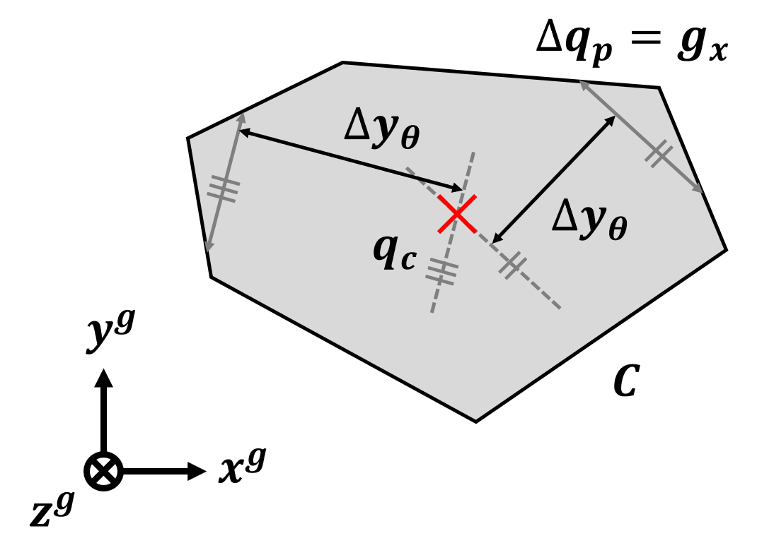
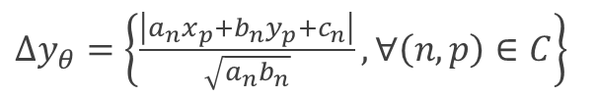
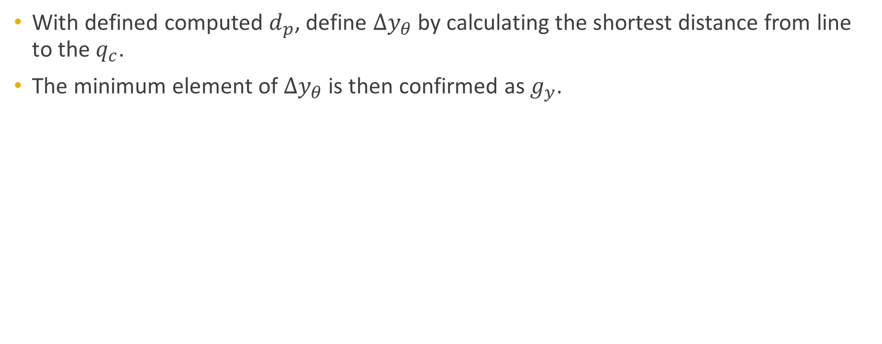
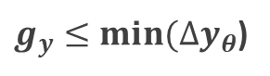
Proposed Solution
Grid generation
With defined computed $d_{p}$, define $∆y_{θ}$ by calculating the shortest distance from line to the $q_{c}$.
The minimum element of $∆y_{θ}$ is then confirmed as $g_{y}$.
$∆y_{θ}=\left\{\frac{\left|a_{n}x_{p}+b_{n}y_{p}+c_{n}\right|}{\sqrt{a_{n}b_{n}}},∀\left(n,p\right)∈C\right\}$
$g_{y}≤min⁡(∆y_{θ}$)

Slide 27
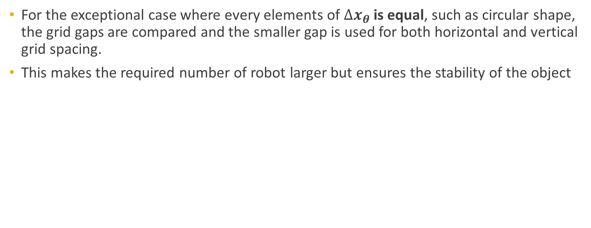
Proposed Solution
Grid generation, exceptional case
For the exceptional case where every elements of $∆x_{θ}$is equal, such as circular shape, the grid gaps are compared and the smaller gap is used for both horizontal and vertical grid spacing.
This makes the required number of robot larger but ensures the stability of the object

Slide 28
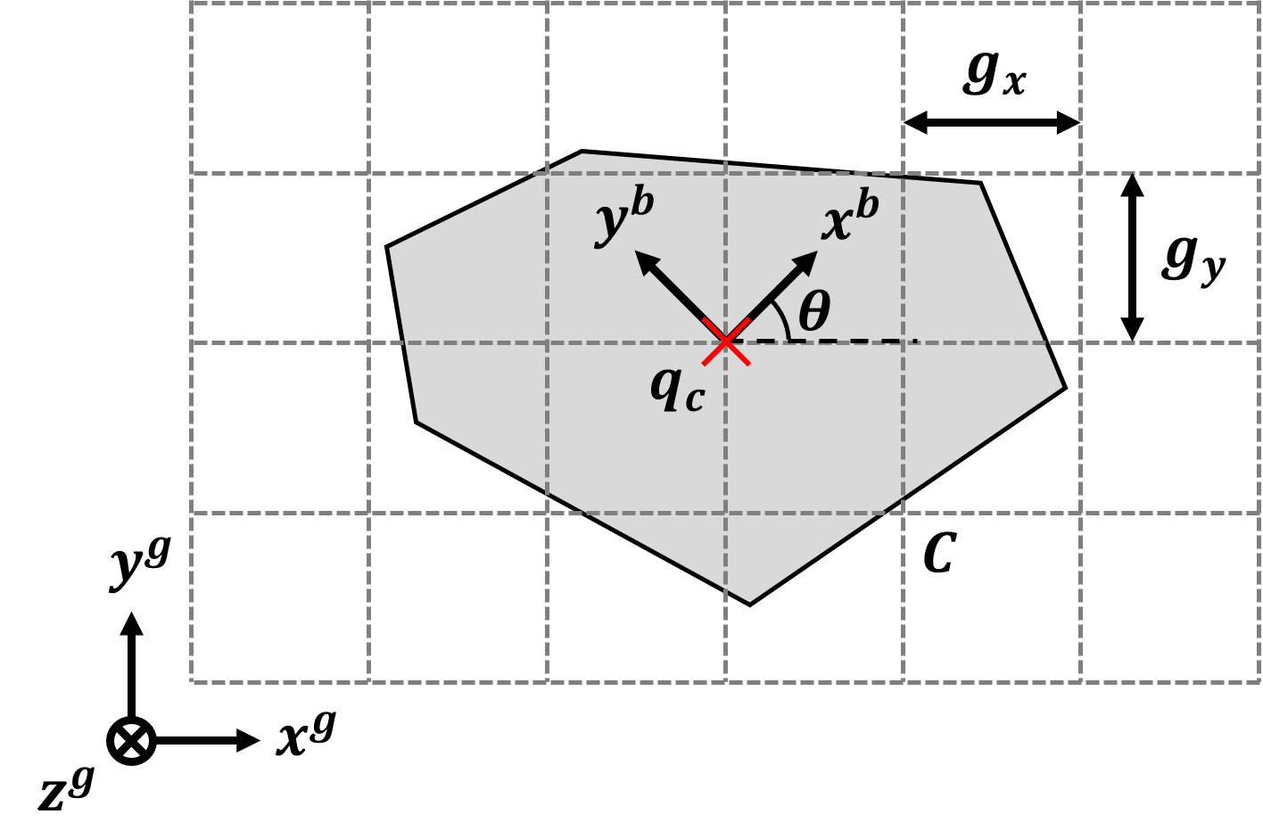
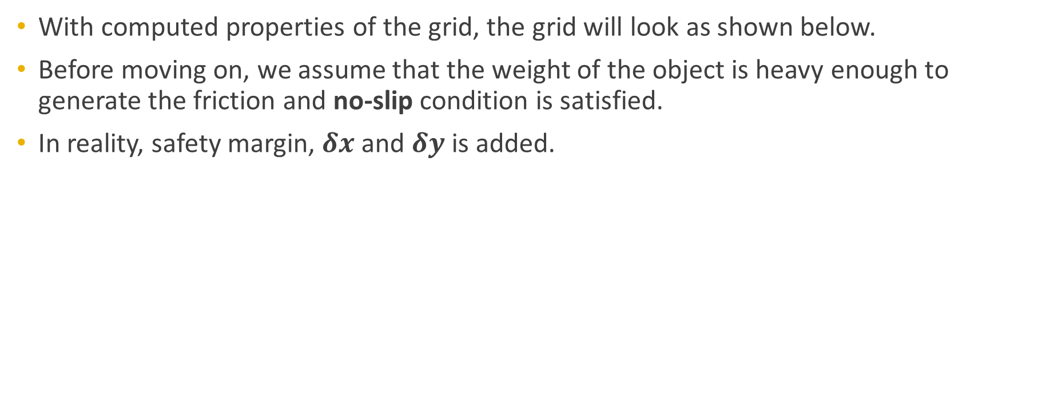
Proposed Solution
Grid generation
With computed properties of the grid, the grid will look as shown below.
Before moving on, we assume that the weight of the object is heavy enough to generate the friction and no-slip condition is satisfied.
In reality, safety margin, $δx$and $δy$ is added.

Slide 29
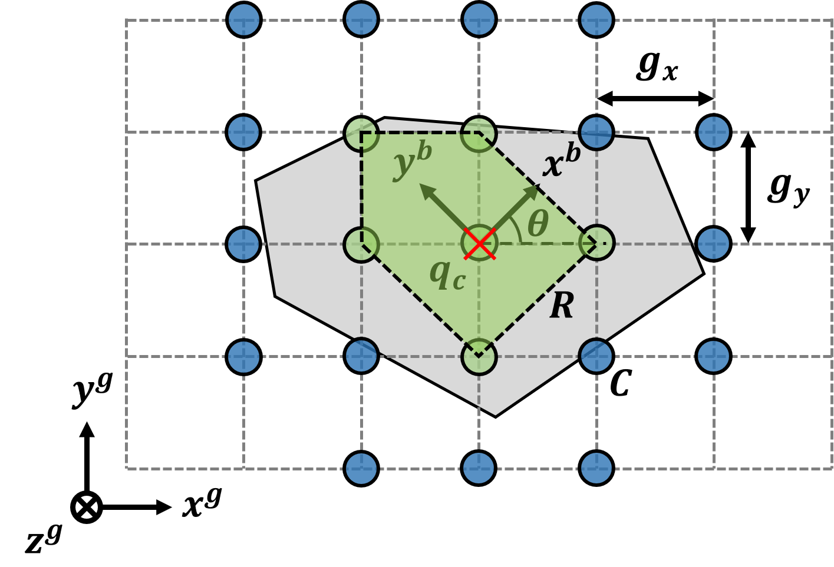
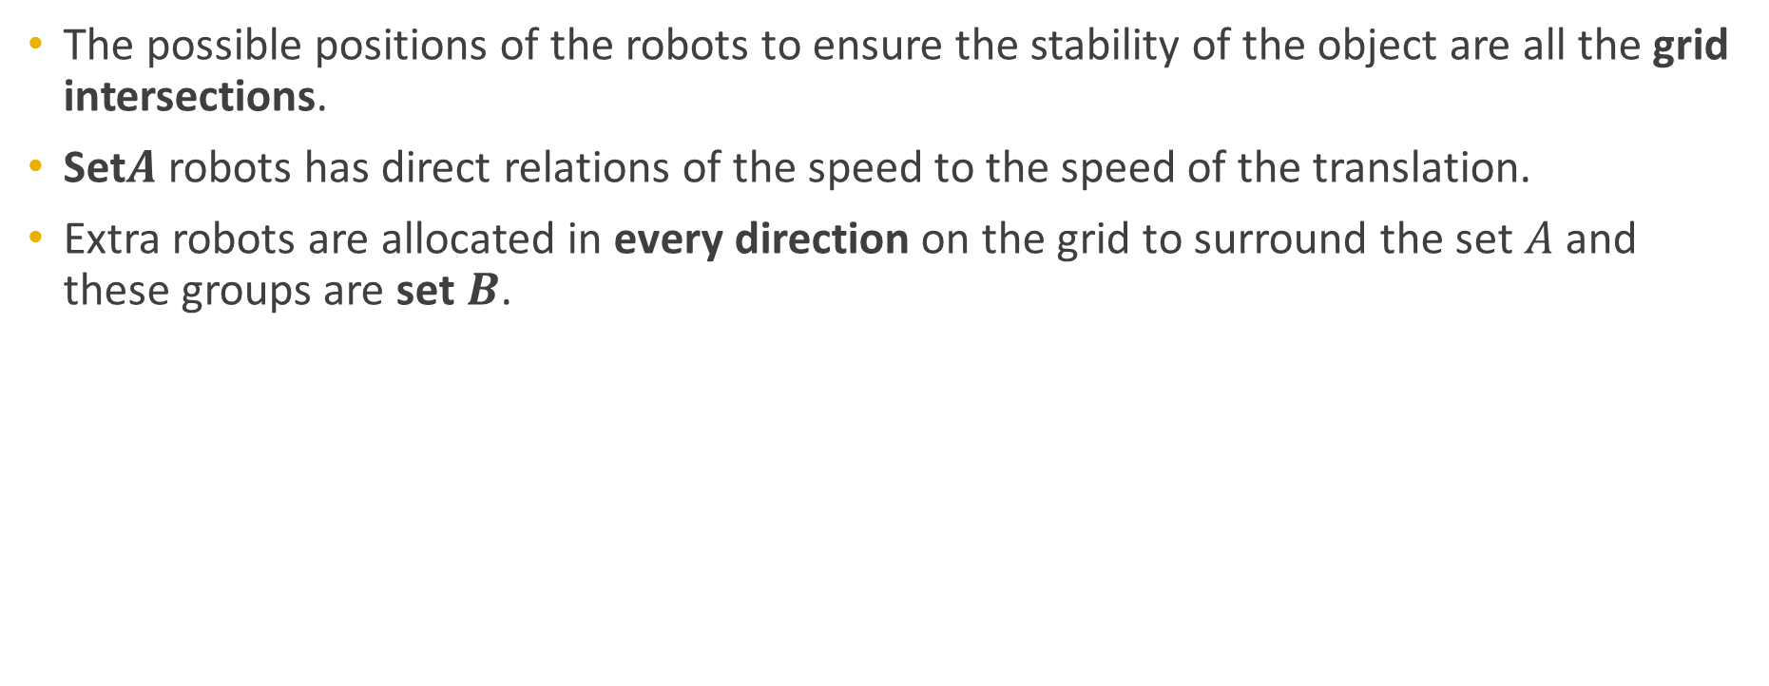
Proposed Solution
Robot allocation
The possible positions of the robots to ensure the stability of the object are all the grid intersections.
Set$A$robots has direct relations of the speed to the speed of the translation.
Extra robots are allocated in every direction on the grid to surround the set $A$ and these groups are set $B$.

Slide 30
Proposed Solution
Robot allocation
The possible positions of the robots to ensure the stability of the object are all the grid intersections.
Set$A$robots has direct relations of the speed to the speed of the translation.
Extra robots are allocated in every direction on the grid to surround the set $A$ and these groups are set $B$.

Slide 31
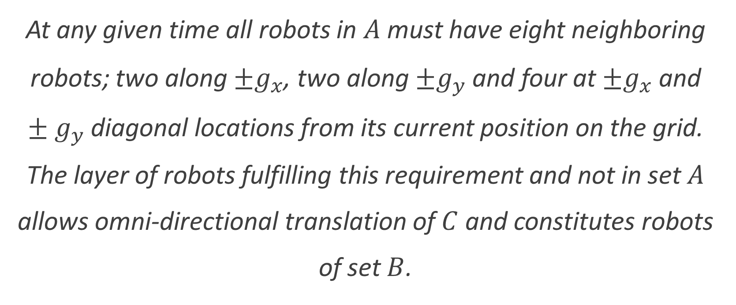
Proposed Solution
Definition 2
At any given time all robots in $A$ must have eight neighboring robots; two along $±g_{x}$, two along $±g_{y}$ and four at $±g_{x}$ and $±g_{y}$ diagonal locations from its current position on the grid. The layer of robots fulfilling this requirement and not in set $A$ allows omni-directional translation of $C$ and constitutes robots of set $B$.

Slide 32
Validation
Matlab simulation, Result and discussion

Slide 33
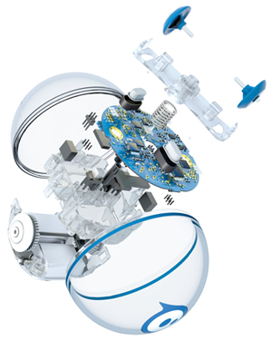
Validation
Hardware
To physically validate the proposed solution, multi-robot system consisting spherical robot is needed. The ideal option for the robot is Sphero.
The economical robot consists multiple sensors such as accelerometer, gyroscope, compass, infrared receiver, infrared emitter, ambient light sensor and motor encoder.
Infrared receiver and emitter, accelerometer and gyroscope can be used to extend the multi-robot system to de-centralized system and autonomous system.

Slide 34
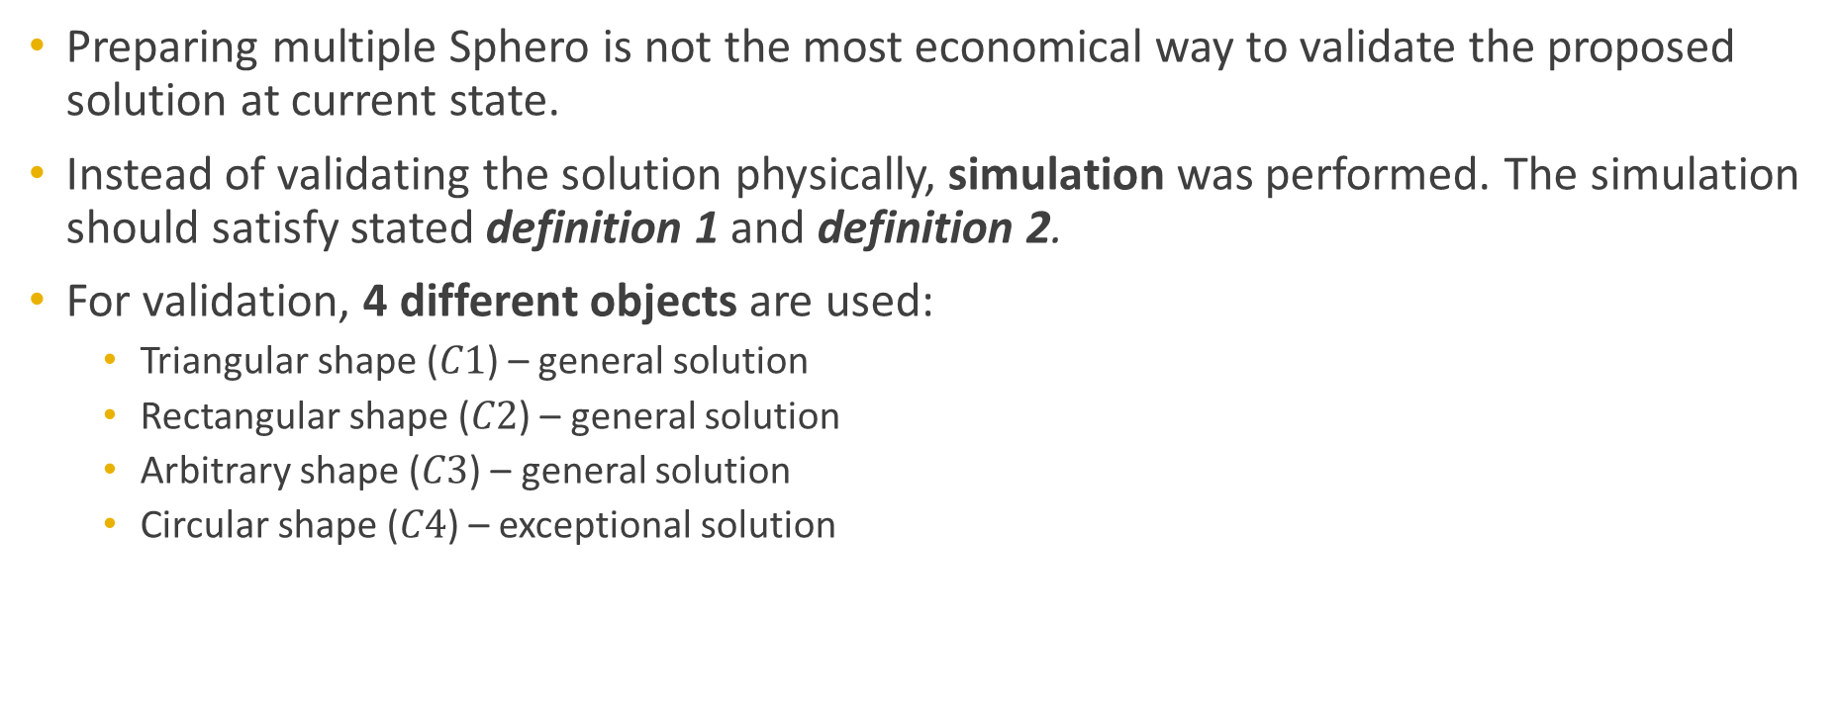
Validation
Simulation setup
Preparing multiple Sphero is not the most economical way to validate the proposed solution at current state.
Instead of validating the solution physically, simulation was performed. The simulation should satisfy stated definition 1 and definition 2.
For validation, 4 different objects are used:
Triangular shape ($C1$) – general solution
Rectangular shape ($C2$) – general solution
Arbitrary shape ($C3$) – general solution
Circular shape ($C4$) – exceptional solution

Slide 35
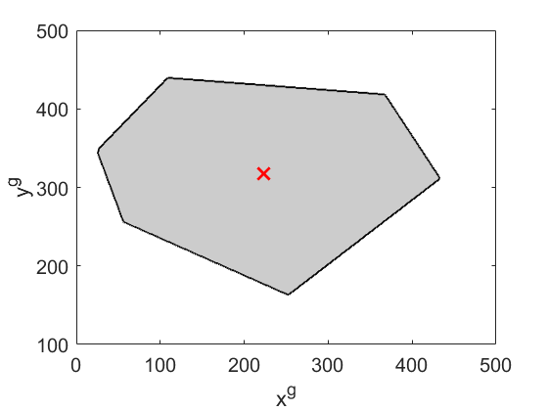

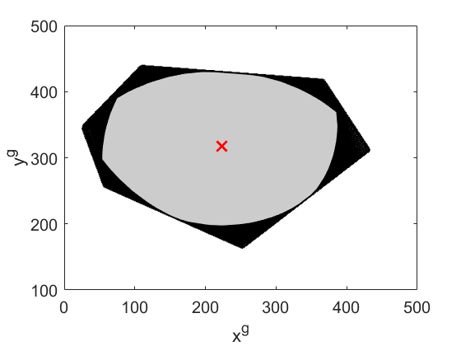






Validation
Grid generation simulation
Using the simulation to compute $g_{x}$ and $g_{y}$ for $C3$.
It followed the stated proposed solution using Matlab.
Same method is applied to the other objects.
Define the object
Compute $g_{x}$
Define $∆q_{p}$ and $d_{p}$
Compute $g_{y}$
$g_{x} \text{=} \text{110.45}$, $g_{y}$= 111.23

Slide 36








Validation
Grid generation simulation
Same method is applied to the other objects.
Grid is dynamic with speed of robot and the simulation shows the relative grid.
C1 (Triangular shape):
$$q_{c}=(3\text{05.71, 259.67}\text{)}$$
$$g_{x}=103.66$$
$$g_{y}=103.66$$
C2 (Rectangular shape):
$$q_{c}=(\text{263.5}\text{, }\text{287.01)}$$
$$g_{x}=104.00$$
$$g_{y}=104.88$$
C3 (Arbitrary shape):
$$q_{c}=(222.80\text{, }\text{317.58)}$$
$$g_{x}=110.45$$
$$g_{y}=111.23$$
C4 (Circular shape):
$$q_{c}=(250.53\text{, }\text{266.52)}$$
$$g_{x}=143.56$$
$$g_{y}=143.56$$

Slide 37








Validation
Robot allocation
Starting location of robots for 4 objects:
C1 (Triangular shape):
$$q_{c}=(3\text{05.71, 259.67}\text{)}$$
$$g_{x}=103.66$$
$$g_{y}=103.66$$
C2 (Rectangular shape):
$$q_{c}=(\text{263.5}\text{, }\text{287.01)}$$
$$g_{x}=104.00$$
$$g_{y}=104.88$$
C3 (Arbitrary shape):
$$q_{c}=(222.80\text{, }\text{317.58)}$$
$$g_{x}=110.45$$
$$g_{y}=111.23$$
C4 (Circular shape):
$$q_{c}=(250.53\text{, }\text{266.52)}$$
$$g_{x}=143.56$$
$$g_{y}=143.56$$

Slide 38



Validation
Simulation Result
Object transportation of C3
$$y^{b}$$
$$x^{b}$$

Slide 39




Validation
Result
C1 transportation result
C2 transportation result
C3 transportation result
C4 transportation result

Slide 40

Conclusion & Future Works
Matlab simulation, Result and discussion

Slide 41
Conclusion & Future works
Conclusion
In this thesis, innovative method of transporting an object is introduced and to efficiently transport the object, Grid-based Cyclic Robot Allocation (GCRA) method is introduced.
The proposed solution was to generate a grid to compute allocation of the robots and the solution was validated using Matlab simulation.
The proposed object carrying method using a multi-robot system of spherical robots can be investigated further on cost and feasibility analysis depending on robot design.

Slide 42

Conclusion & Future works
Future Works
With successful multi-robot allocation, further work on developing multi-robot formation control will be studied and applied.
With the successful development of the control system, the validation can be extended to the real-life experiment or 3-dimensional simulation environment.

Slide 43
Thank You.
Jee Hwan Park
765 479 2539
park458@purdue.edu

